Slide 1
Design and Implementation of a Wireless Fall Detection Network Prototype using MEMS sensors
Ho Ngoc Khang Minh - Matriculation number: 1148602
1st Supervisor: Prof. Dr. –Ing Kira Kastell
2nd Supervisor: Dipl –Ing. Mohammad Reza Mansooji
Frankfurt am Main, September 2018

Slide 2
AGENDA
Introduction to falls
Causes and Consequences of falls
Literature Review
Objectives
Methodology and Algorithm
System Intergration
Data Collection
Result
Discussion

Slide 3
Introduction to falls
1 in 3 people with
Every 19 minutes
200 falls result in
ONE
faller dies
65+ years old
fall once per year
hip fracture

Slide 4
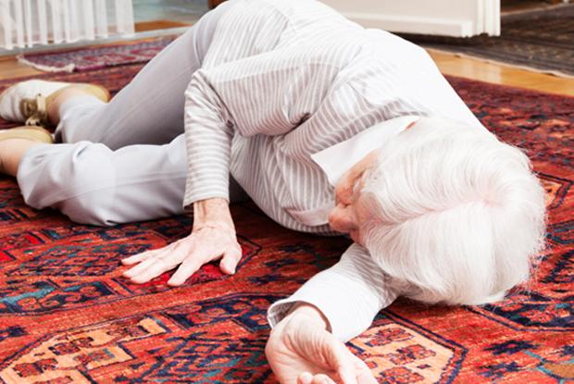
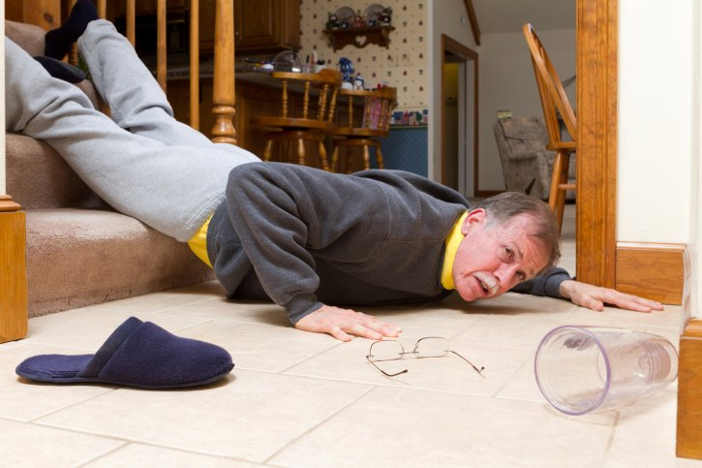
Causes of a fall
Intrinsic factors
Cognitive Impairment
Postural control
Cardiovascular problem
Extrinsic factors
Dim lighting or glare
Bad staircase design

Slide 5
Consequences of falls
Physical consequences
Hip fractures
- A quarter million hip fractures occur each year
Half of them cannot live independently
$3 billions for medical treatment
Head Injuries
- 10 – 15% admission to the hospital because of head injuries caused by falls
Death
- 36.8 / 100 000 people die every year because of falls

Slide 6
Consequences of falls
Psychological consequences
Fear of falling again prevents them from their daily activity
Stop going out or physical activities
Increase the risk of falling because of physical function attenuation

Slide 7
Consequences of falls
Other consequences
Dependency
Some cannot live independently
Need long-term nursing care
Hospital admission
- In England (1998), 200 000 people of 65+ are treated
Economic burden
- In U.S. (2015), $50 billion being used for fall injuries
- Expected to reach $67.7 billion by 2020

Slide 8
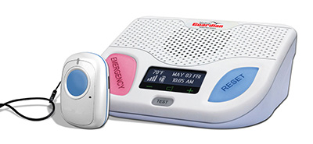
Literature Review
Existing Commercial Devices
- Including one base station & one neck pendant
When detecting a fall, pendant send signal to base
- If the patient actually needs help, not press button
- Automatically contact with monitoring center
- $44.95 / month
Fig 1. Medical Guadian Fall Alert System

Slide 9
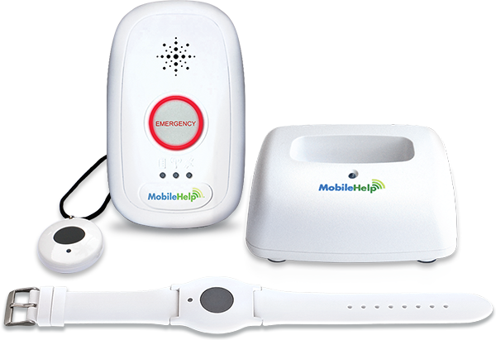
Literature Review
Existing Commercial Devices
- Detect fall
- Monitoring heart rate
- Sleep/wake pattern
- Location of patient
- Cellular network
- $41.95 / month
Fig 2. myHalo Medical Alert System

Slide 10
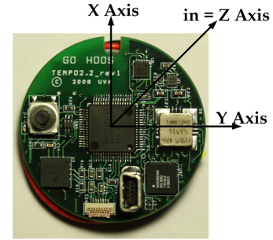
Literature Review
Existing Research
+ From Qiang Li and colleagues
+ Including one gyroscope and one accelerometer
+ Combine data from both sensor
- Difficulty in differentiate jumping into bed and
falling against a wall
Fig 3. Tempo 3.0 sensor node

Slide 11
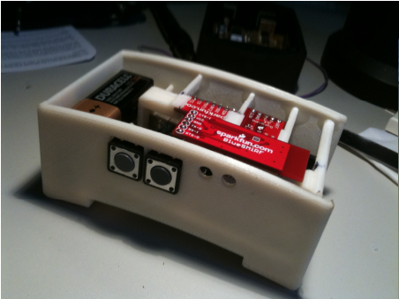
Literature Review
Existing Research
+ From Binh Nguyen & Tomkun
+ Using only one accelerometer
+ Automatically call 911 when detecting
a fall
+ Visual LED indicator
- Some action cannot be distinguished by
propose algorithm
Fig 4. Product of Binh Nguyen’s group

Slide 12
Project objective
Design a falling detection network
1
Sending alert signal to care-givers
2

Slide 13
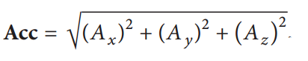
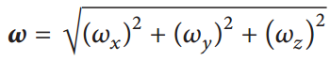
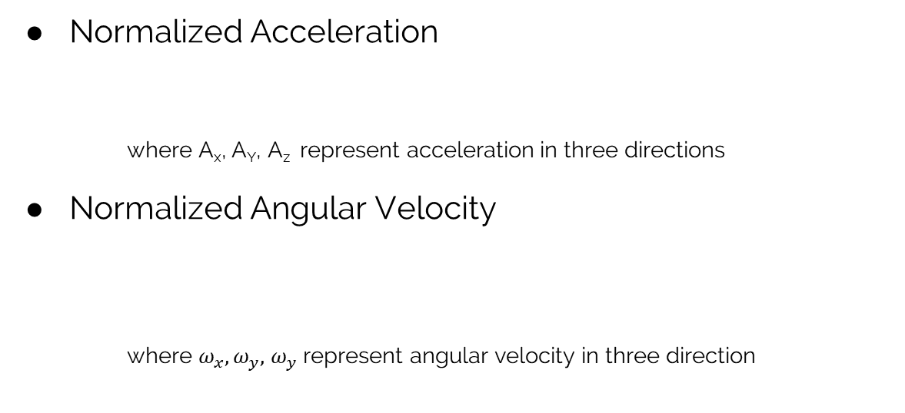
Methodology & Algorithm
Normalized Acceleration
where A_{x}, A_{Y}, A_{z} represent acceleration in three directions
Normalized Angular Velocity
where $ω_{x}, ω_{y},$ $ω_{y}$ represent angular velocity in three direction

Slide 14
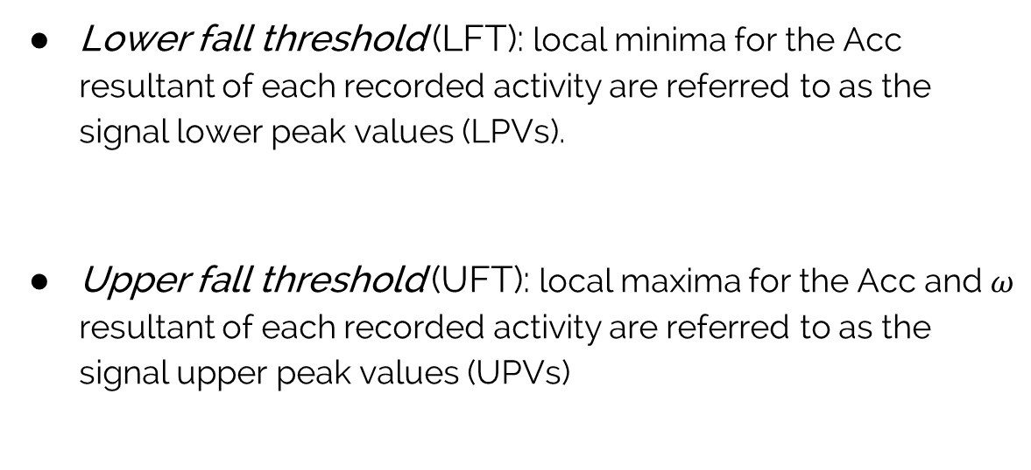
Algorithm
Lower fall threshold (LFT): local minima for the Acc resultant of each recorded activity are referred to as the signal lower peak values (LPVs).
Upper fall threshold (UFT): local maxima for the Acc and $ω$ resultant of each recorded activity are referred to as the signal upper peak values (UPVs)

Slide 15
Algorithm
3 Threshold Types
LFT_{Acc} : lower limit for acceleration
UFT_{Acc} : upper limit for acceleration
UFT_{Gyro}: upper limit for angular velocity

Slide 16
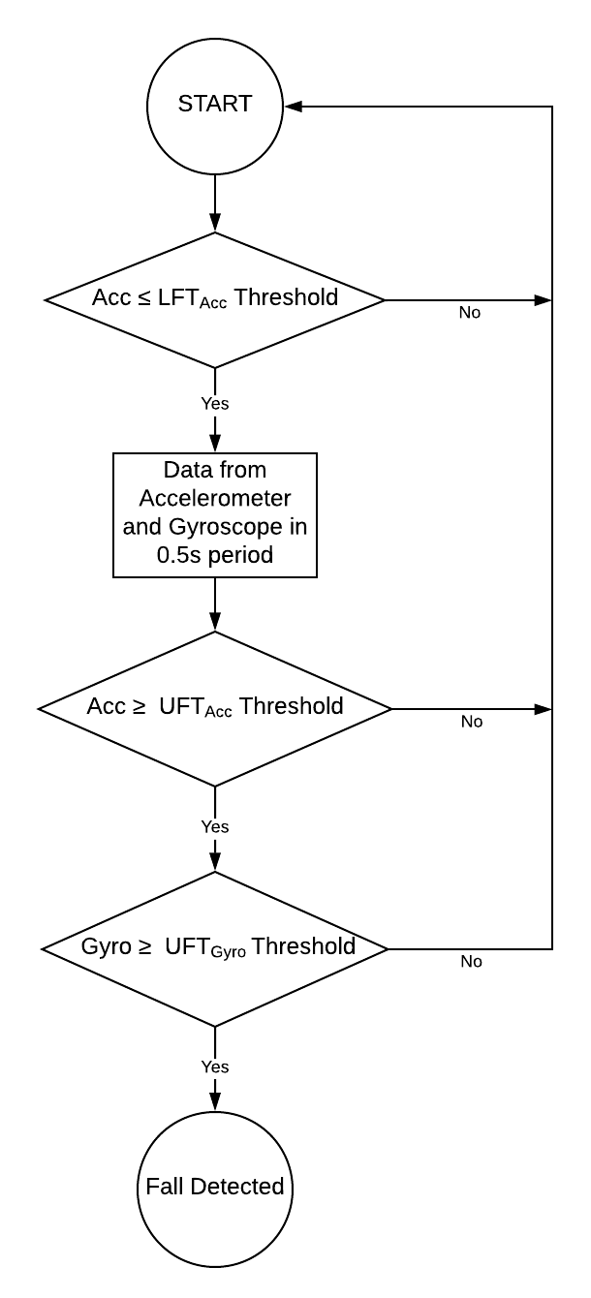
Algorithm
*Nominated by Quoc T. Huynh et. al. [1]

Slide 17
System Overview

Slide 18
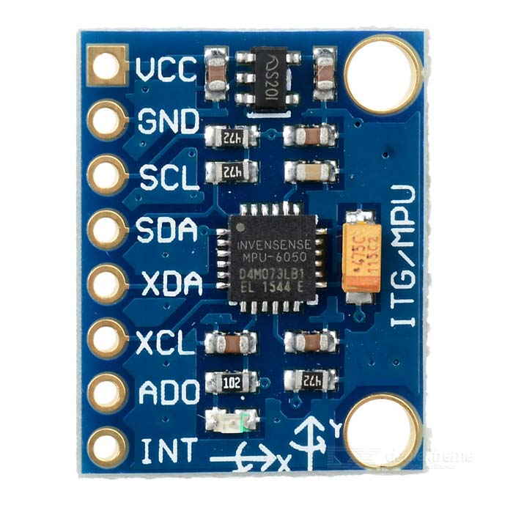
SENSORS
Inertia Measurement Unit (IMU) - MPU6050
Accelerometer
full-scale range of ±2g, ±4g, ±8g,
and ±16g.
Gyroscope
full-scale range of ±250, ±500, ±1000,
and ±2000 °/sec (dps)
Fig 5. MPU-6050 sensor

Slide 19
DATA FUSION
Sensors Characteristics
Accelerometer
Sensitive with any sudden small force
Data is reliable in long term
Gyroscope
Drift over time
Give accurate information, not affected by
external force
Fig 5. MPU-6050 sensor

Slide 20
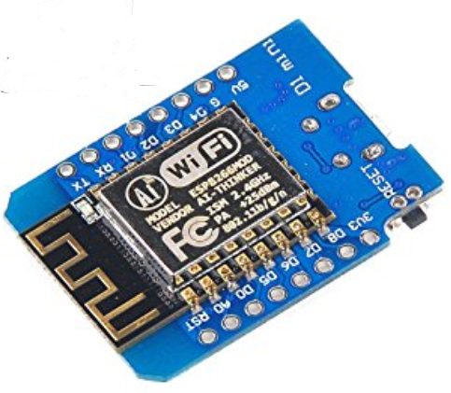
MICRO-CONTROLER
ESP8266EX
- L106 32-bit RISC processor
- Maximum clock speed 160Mhz
- Supports GPIO, UART, I²C, ADC, etc.
- 50kB RAM and 16MB SPI flash
Fig 5. ESP8266EX

Slide 21
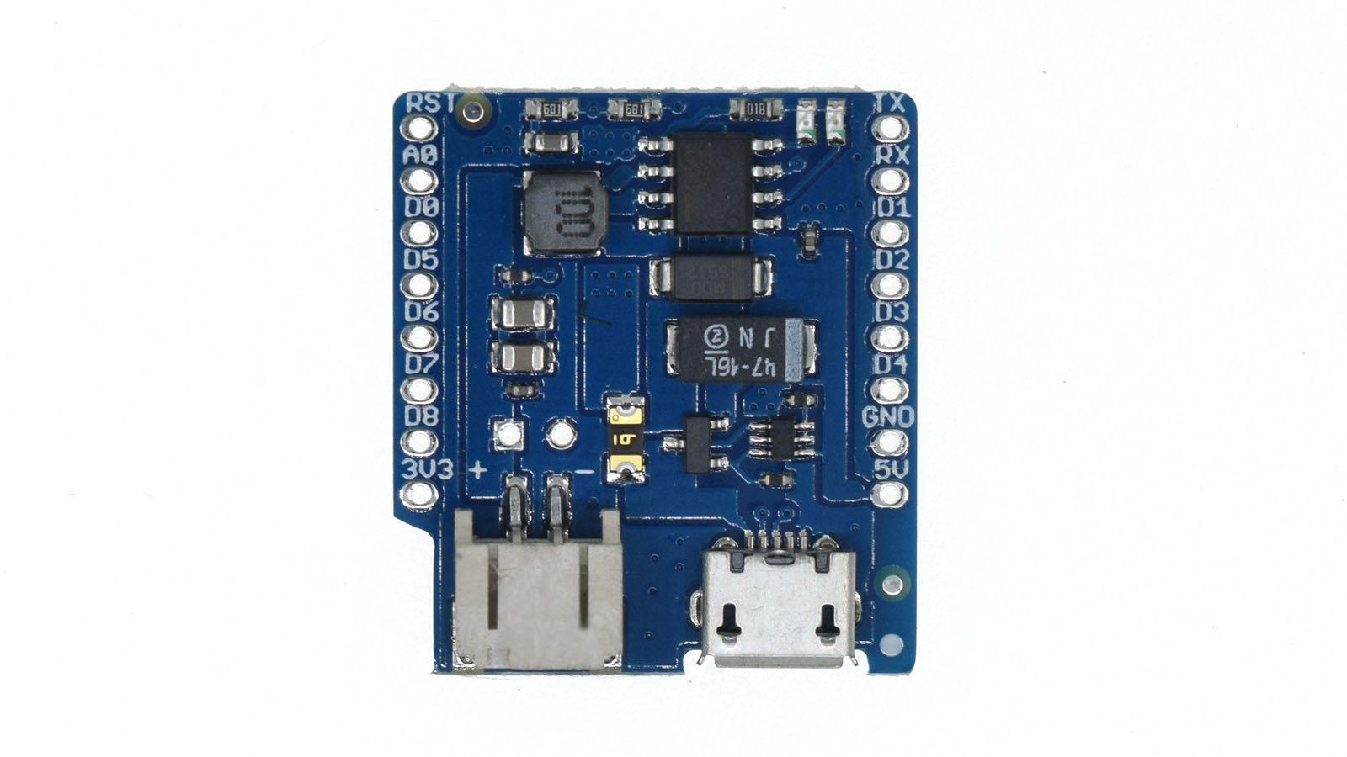
POWER SUPPLY
ESP8266 Power Supply Shield
- Compitable with ESP8266 board
- Provide 5V power supply
- Support Lithium Battery
- Allow battery charging
Fig 6. ESP8266 power shield

Slide 22
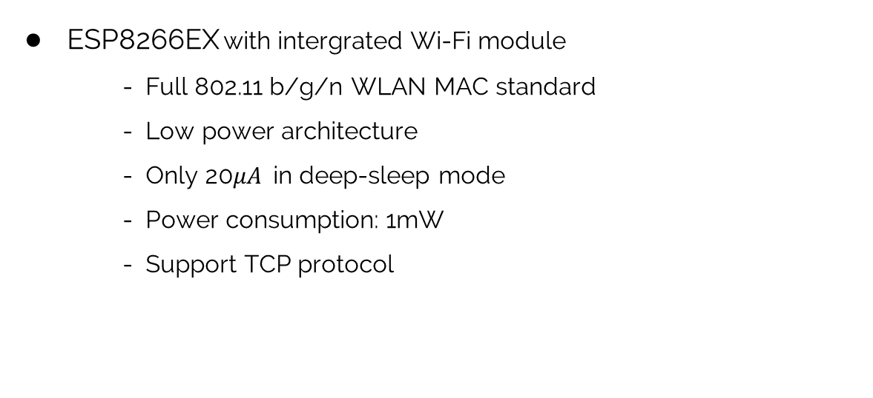
COMMUNICATION
ESP8266EX with intergrated Wi-Fi module
- Full 802.11 b/g/n WLAN MAC standard
- Low power architecture
- Only 20$μA$in deep-sleep mode
- Power consumption: 1mW
- Support TCP protocol
Fig 7. ESP8266 WiFi module

Slide 23
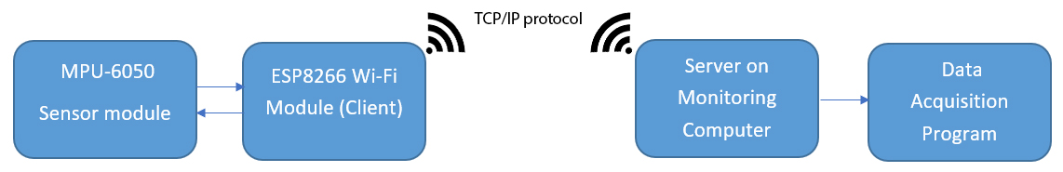
COMMUNICATION
Fig 8. Communication protocol

Slide 24
SOFTWARE
Embedded Software
- Read data from sensor
- Calculate normalized values
- Concatenating data into message
- Sending data to host computer

Slide 25
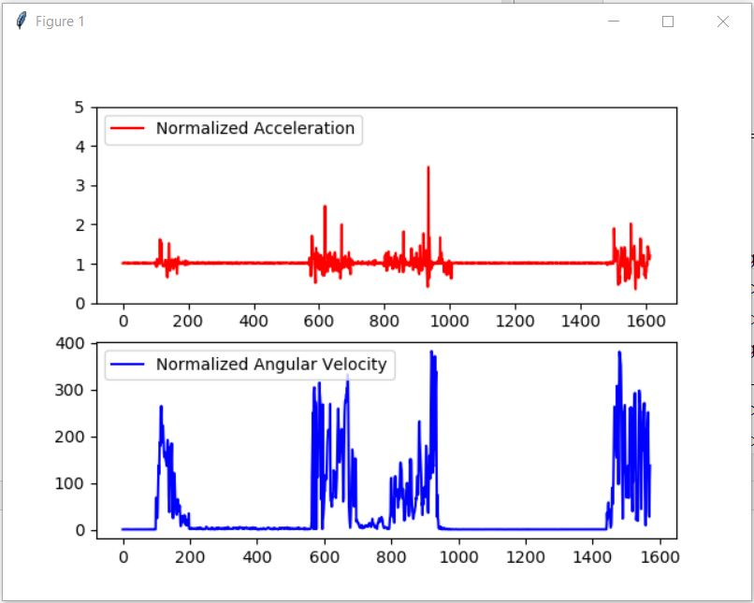
SOFTWARE
Data acquisition software
- Running a server
- Read data from received message
- Visualize data
- Store data into CSV file

Slide 26
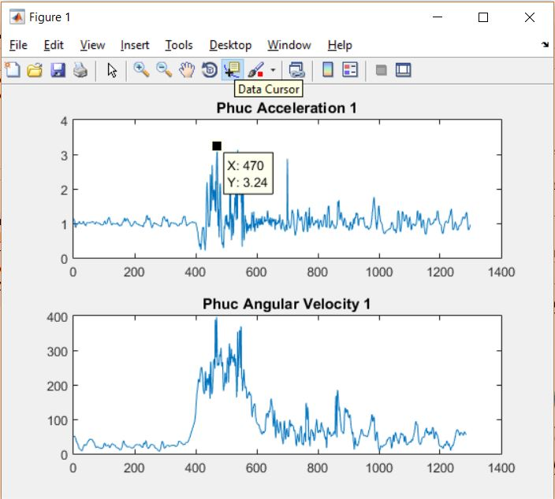
SOFTWARE
Data analysis software: MATLAB
- Reading data from CSV file
- Load data to MATLAB array
- Plotting data
- Analyze data with provided tools

Slide 27
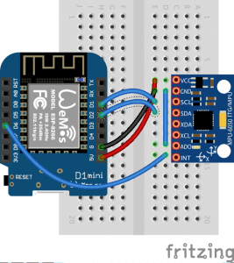
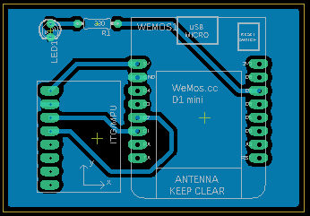
SYSTEM INTEGRATION

Slide 28
Testing Method

Slide 29
Results

Slide 30
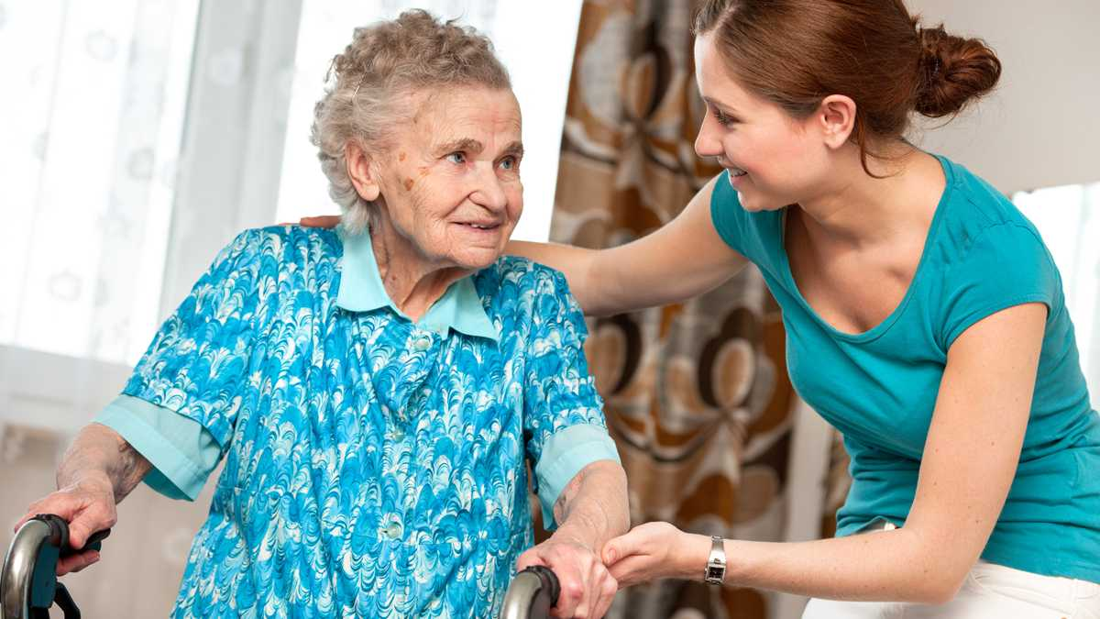


Further Development
Mobile Platform
Machine Learning method
Pre-fall prediction
01
03
Use integrated sensors on the smart phone to make it easy for you user to carry with them
02
Improve the correct of falling detection with a bunch of training data set
Use modern technique in machine learning to predict whether patient will fall or not

Slide 31
Reference
[1] Quoc T. Huynh, Uyen D. Nguyen, Lucia B. Irazabal, Nazanin Ghassemian, and Binh Q. Tran, “Optimization of an Accelerometer and Gyroscope-Based Fall Detection Algorithm”, Journal of Sensors.
[2] J. G.-A. Pedro Rodrigues, "Fall detection systems to be used by elderly people," in Handbook of Research on ICTs for Human-Centered Healthcare and Social Care, p. 87.J. G.-A. Pedro Rodrigues, "Fall detection systems to be used by elderly people," in Handbook of Research on ICTs for Human-Centered Healthcare and Social Care, p. 87.
[3]A. Bueno-Cavanillas, F. Padilla-Ruiz, J. J. Jimenez-Mole ´ on, ´C. A. Peinado-Alonso, and R. Galvez-Vargas, “Risk factors in ´falls among the elderly according to extrinsic and intrinsic precipitating causes,” European Journal of Epidemiology, vol. 16, no. 9, pp. 849–859, 2000.

Slide 32
Thank you.

